Slide 1
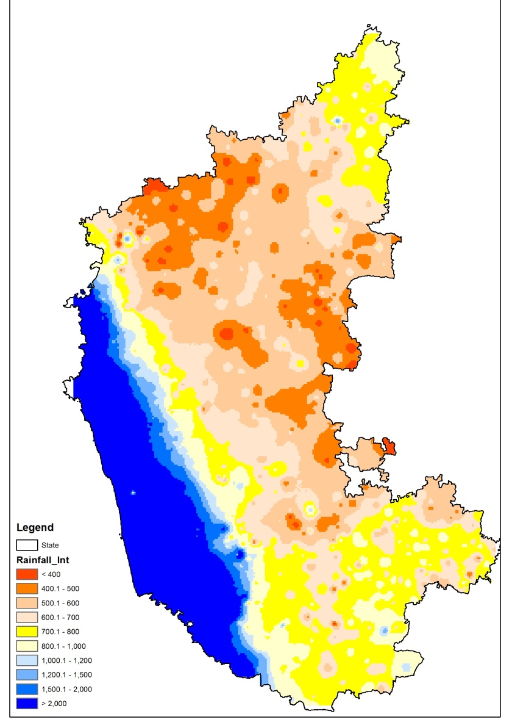
Karnataka State Water Informatics Centre (SWIC) –
Introduction and Status Update
ACIWRM
June 18, 2022

Slide 2
Status
ACIWRM & WRDO attended the “Introductory Session on State Water Informatics Centre (SWIC)” on 26th July 2021, organized by NWIC; vide WRDO Letter dated 22-07-2021 it was suggested KWRIS to act as State Level WRIS.
In a meeting held on 28th Feb 2022, under the chairmanship of Additional Chief Secretary to Govt., WRD it was opined to make ACIWRM the nodal agency to SWIC
ACIWRM provided suggestions regarding setting up of “State Water Informatics Centre [SWIC]” and to updated/submitted the information about the status of Water Resources Information dissemination setup at state level in the Table-1 of the concept note, on 07-03-2022 in response to a letter from Additional Chief Secretary, Water Resources Department.

Slide 3
IMPACT
Enhanced access and security of water resources and services in the river basin
Framework in Karnataka
Institutions and Policies for IWRM
Integrated
River Basin Management
Water Use Efficiency and Water Productivity
IWRM Based Irrigation Management
KEY THEMES
Data, Information, and
Knowledge Management
Stakeholder Involvement and
Capacity Building
SUPPORTING THEMES

Slide 4
National Water Policy context for setting up of SWIC
The National Water Policy 2002, dealt with Information System in Paras 2.1, 2.2 & 2.3:
  2.1 A well-developed information system, for water related data in its entirety, at the national/ state level
  2.2 Standards for coding, classification, processing of data and methods / procedures for its collection should be adopted
  2.3 Apart from the data regarding water availability and actual water use, the system should also include comprehensive and reliable projections of current and future demands of water
The National Water Policy 2012 in its Section 14 dealt with Database & Information System:
  14.1 A National Water Informatics Centre should be established

Slide 5
State Water Policy context for setting up of Information systems in Karnataka
3.8.1 A State wide ‘Karnataka Water Resources Information System’ (KWRIS) will be developed. This will integrate data collected and maintained by the various government agency data custodians and according to national data standards. 3.8.2 Hydro-meteorological; surface water; groundwater; quantity and quality; monitoring networks will be reviewed and upgraded as necessary to address the new emerging challenges. Land and water use and demands will be assessed from time to time. 3.8.3 Institutional arrangements to collect, monitor and process all the water data parameters will be reviewed and a single agency being responsible for these responsibilities will be explored, like WRDO under WRD with expanded multi-disciplinary team 3.8.4 A State ‘Karnataka Water Resources Inventory’ will be produced to assess the extent, uses and condition of the State’s water resources and to form a basis for determining future policy, river basin and sub-basin planning needs.

Slide 6
Need for SWIC
Data available with state is fragmented and stored in various forms across many departments/ organisations/ establishments of the concerned State.
For proper planning of water resources in terms of demand and supply side management, developing advance analytical tools and models, applications and Decision Support System, a centralized data platform integrated with geo-spatial data is the minimum requirement, along with adoption of uniform practice of data acquisition, validation and storage.
States collect enormous micro level data for water and allied themes and as data collection is carried out by different departments, a dedicated body is needed as data repository and to formulate policy towards uniform data acquisition, standardization, validation, analysis and dissemination.
This dedicated body at State level would establish a mechanism for coordination among data generating organizations, users, planners, academicians and all other stake holders.
5. Achieving real improvement in water resources management will only be possible when data from all over the region is available to all the stakeholders at a single platform.

Slide 7
Overview and Comparison of IWRIS & WIMS and KWRIS
S.No | IWRIS, WIMS | KWRIS
1 | The National Water Informatics Centre (NWIC) manages India WRIS portal (www.indiawris.gov.in), a single window solution for all water resources data and information in a standardized national GIS framework. It allows users to Search, Access, Visualize, Understand and Analyse comprehensive and contextual water data for the assessment, monitoring, planning and development of water resources in the context of Integrated Water Resources Management (IWRM). Utilities like Online Web Editor, Data/Report download, Data availability facilitates users to browse through the available data, download the required information and update the state specific data. | The ACIWRM manages the KWRIS Portal – https://water.Karnataka.gov.in, single window portal hosted at State Data Centre maintained by e-Governance Department of the State KWRIS developed in the context of data warehouse with GIS framework Allows visualization and bulk data download with Access control

Slide 8
Overview and Comparison of IWRIS & WIMS and KWRIS
S.No | IWRIS, WIMS | KWRIS
1 | A. Surface Water Module Reservoir level: Minor irrigation tanks: Reservoir Sediment Study: Surface Water Bodies:. Rivers Monitoring:. Snow-Glacial Lakes: WetlandsSurface water quality: The data on 66 parameters measured for water quality is available on a monthly level from aug-1963 to march,2020. Discharge Measuring Stations on Canals: | Surface water Module Major Reservoirs daily data collected by a KWRIS app, generates specific reports for ISW, CWMA, CWRC Minor Irrigation tanks – We have attribute data, the spatial identification and correction is under progress Surface Water Bodies: Have spatial information, additional information to be added River Monitoring: Monthly stream flow data collected, for daily data and app to be created

Slide 9
Overview and Comparison of IWRIS & WIMS and KWRIS
S.No | IWRIS, WIMS | KWRIS
1 | B. Ground Water Module The modules containing ground water data are: Ground water level: Ground water quality: Groundwater Resources: Groundwater Prospects:. Litholog: Aquifer systems: Artificial Recharge structure- Viewer: | B. Ground Water Module Ground water level: Monthly data integrated, daily DWLR data to be integrated Ground water quality: Historical data made available, Master Well data correction is under progress Groundwater Resources: To be done in discussion with GWD Groundwater Prospects: To be done in discussion with GWD Litholog: Framework is available, data to be obtained Aquifer systems: State GWD maps area available Artificial Recharge structure- Viewer: To be obtained

Slide 10
Overview and Comparison of IWRIS & WIMS and KWRIS
S.No | IWRIS, WIMS | KWRIS
1 | C. Hydro-Meteorological Data Rainfall Evapotranspiration Soil Moisture Agro-Climatic / Ecological zones | C. Hydro-Meteorological Data Rainfall – Sources: WRD, KSNDMC and IMD. Data available: WRD, Manual, SMS, Telemetry Evapotranspiration – SEBAL and SSEBoP method – Monthly AET – 1 sq.km resolution Soil Moisture – SMAP – Once in three days, 10 Sq Km resolution Agro-Climatic / Ecological zones – Maps are available

Slide 11
Overview and Comparison of IWRIS & WIMS and KWRIS
S.No | IWRIS, WIMS | KWRIS
1 | D. Land Resources Land use / Land cover Soil Land Degradation Water logging / Soil Salinity Waste land | D. Land Resources Land use / Land cover – 2011-12 to 2018-2019 NRSC maps, 1: 50, 000 scale images Soil – Available – To integrate the Maps available from KSRSAC – profile, nutrients etc Land Degradation – Digitized from NBSS-LUP map Water logging / Soil Salinity - Digitized from NBSS-LUP map Waste land – To be obtained from KSRSAC Watershed – Recent map Obtained form SLUSI

Slide 12
Challenges in setting up of SWIC
1. Several agencies, domain specific, such as, WRDO, GWD, Minor Irrigation, Agriculture & allied agencies, KSNDMC, etc. collecting, monitoring, consolidating the data related to their respective jurisdictions.
2. Lack of coordination among these agencies and getting data from these different organizations for aggregation becomes a humongous task.
3. Non-uniformity in data collection, data format, attribute identification, frequency of data collection etc. thus causing difficulties for data conversion, validation, integration and consolidation at one platform.
4. Overlapping of jurisdictions, between agencies, hence dual data collection
5. Lack of diverse technical and administrative skills in IT enabled GIS platforms as they have not been the core functions of water resources department conventionally
6. A defined funding requirement and funding mechanism is not in place for creating and sustaining such dedicated body at the state level.
7. Lacking state level strategy for integrated water resources management aimed at achieving local level water security

Slide 13
Benefits of Setting up of SWIC
a) Standards & Policies will be in place for schema, data exchange/ sharing, data quality, validation rules, metadata and reporting
b) Reusable and Interoperable: Base data, Schema, infrastructure, application architecture, APIs/Webservices licenses will be interoperable and accessible to all departments/agencies
c) Ease of Access and access control with data security to all stakeholders
d) Cost-Effectiveness in having single data base without agencies setting up separate data centres
e) Knowledge Centre: Experts with domain knowledge with a cohesive team will be in place for the States/ Centre for the water sector as a whole.

Slide 14
NWIC Proposed Solution

Slide 15
Solution: Model 2: Karnataka State
This group comprises of the States with an already established, full featured working WRIS platform with Database, GIS layers, Web-based multi-user & public access platform Visualization, and Reports, Data collection & validation systems and hosting platform (own or cloud) (Table 2: Case VI).
The state can continue with their setup for the State-WRIS. Sharing of information across NWIC and SWIC shall be by means of APIs, Map services (WMS/WFS), and other modes of data sharing mechanisms, as needed from time to time. These states have the option to switch over to Model 1 anytime in the future.

Slide 16
Scope of SWIC
SWIC shall act as a as a nodal agency for integration of water resources data within the state and act as a repository for state-wide water resources data and will be responsible for maintaining, updating, collation and dissemination of data and information.
In co-ordination with NWIC, the SWIC shall act as a single-point solution for regional and micro-level water resources data amalgamation and its dissemination.
Collection of Water Data (Micro level)
Setting up of regular mechanism for periodic collection & integrating telemetry systems in various agencies
Data validation – Primary (agencies) & Secondary (largely)
Generation of additional time-series of geospatial data as per State requirement (other than NWIC specified)
State specific Visualization, Dashboards & reports
Specific Applications and Decision Support Systems (DSS)

Slide 17
Need for K-CWRDS and K-WRPMMS - Various Aspects of Water Resources Management in Karnataka Requiring Data Services
It is proposed that the K‐CWRDS and K‐WRPMMS be constituted as an integrated system of hydro-meteorological data networks designed around the following priority aspects/ objectives, namely:
Surface water management;
Ground water management;
Water quality - surface water and ground water;
Sediment transport monitoring;
Meteorological forecast;
Integrated Water Resources Management/ Integrated River Basin Management;
Irrigation/ agriculture water management;
Domestic water management (including for household livestock);
Industrial and power water management;
Water disaster management (drought, flood, cyclone, climate change);
Water for eco-system (including for freshwater biomes and freshwater fishery); and
Water resources management performance monitoring/ index

Slide 18
Scope of K‐CWRDS and KWRPMMS - Seven Essential Elements
Identifying the priority water management objectives for Karnataka;
Implementing an effective water data acquisition and information management system;
Adopting internationally accredited water data standards;
Employing a robust water data quality management process;
Establishing a sustainable water data monitoring system;
Embracing an open data approach to water data access and licensing; and
Strengthening water data institutions

Slide 19
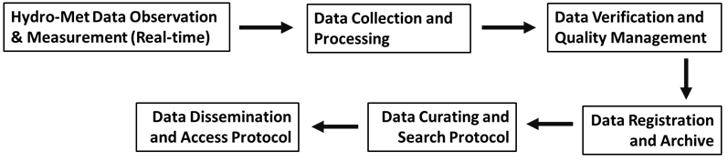
K-CWRDS and K-WRMMS Information System - the Data Workflow Process
The suggested workflow process from hydro-meteorological data observation and measurement step to data dissemination for the K-CWRDS and K-WRMMS information system:
It is proposed that K-CWRDS and K-WRMMS Information System adopt data workflow process practices as recommended by WMO in its publication – “WMO, 2008. Guide to Hydrological Practices Volume I: Hydrology - From Measurement to Hydrological Information”.

Slide 20
K-CWRDS and K-WRMMS – Institutional Arrangements
Sl. No. | Team Member | Responsibilities
1 | K-CWRDS & K-WRPMMS Information System Manager | Data system management and geo-spatial data management
A | Water Resources Team
1 | Hydrologist | Surface water data management
2 | Geo-hydrologist | Ground water data management
3 | Water Quality Specialist/ Environmental Scientist | Water quality data management
4 | Meteorologist | Meteorological data management
5 | Irrigation MOM Engineer | Irrigation data management
6 | Environmental Engineer / Ecologist | Water Disaster / Water Eco-system Data Management
7 | Monitoring and Evaluation Expert | Performance Audit, Benchmarking and Water Index
8 | Data Quality Standard and Quality Management System Manager | Hydro-meteorological data quality standards and QM system management
9 | Quality Management System Auditor | Hydro-meteorological data quality standards and QM system audit
K-CWRDS & K-WRPMMS Information System - Human Resources Needs and Capacity Building

Slide 21
K-CWRDS and K-WRPMMS – Staffing Cost Estimate (in Lakh INR/Year)
Sl. No. | Cost Head | Amount
C | SWRDIC/ SWIC Team Cost
1 | K-CWRDS & K-WRPMMS Information System Manager | 24.98
2 | Hydrologist | 18.73
3 | Geo-hydrologist | 18.73
4 | Water Quality Specialist/ Environmental Scientist | 18.73
5 | Meteorologist | 18.73
6 | Irrigation MOM Engineer | 18.73
7 | Environmental Engineer / Ecologist | 18.73
8 | Monitoring and Evaluation Expert | 18.73
9 | Data Quality Standard and Quality Management System Manager | 18.73
10 | Quality Management System Auditor | 18.73
11 | Database Manager/ Data Management Specialist | 18.73
12 | Systems Analyst | 18.73
13 | Web GIS Developer | 18.73
14 | Application Developer/ Mobile Application Developer | 18.73
15 | User Interface Expert | 18.73
16 | Data Communication Specialist | 18.73
17 | Data Scientist | 18.73
18 | GIS / Remote Sensing Specialist | 18.73
 | Sub-Total | 343.41

Slide 22
NWIC – Support to KSWIC
Technical guidance and support for all the developments related to geo-spatial & timeseries data aggregation and standardization, Software & Hardware Technologies including Development & Production Environment Setup, Hosting etc.
Standards for data and GIS layers
Integration with India-WRIS (NWIC) and access to Data for inter-operability
Data validation tools from time to time (updates)
Financial support for further development and core specialist staffing resources

Slide 23
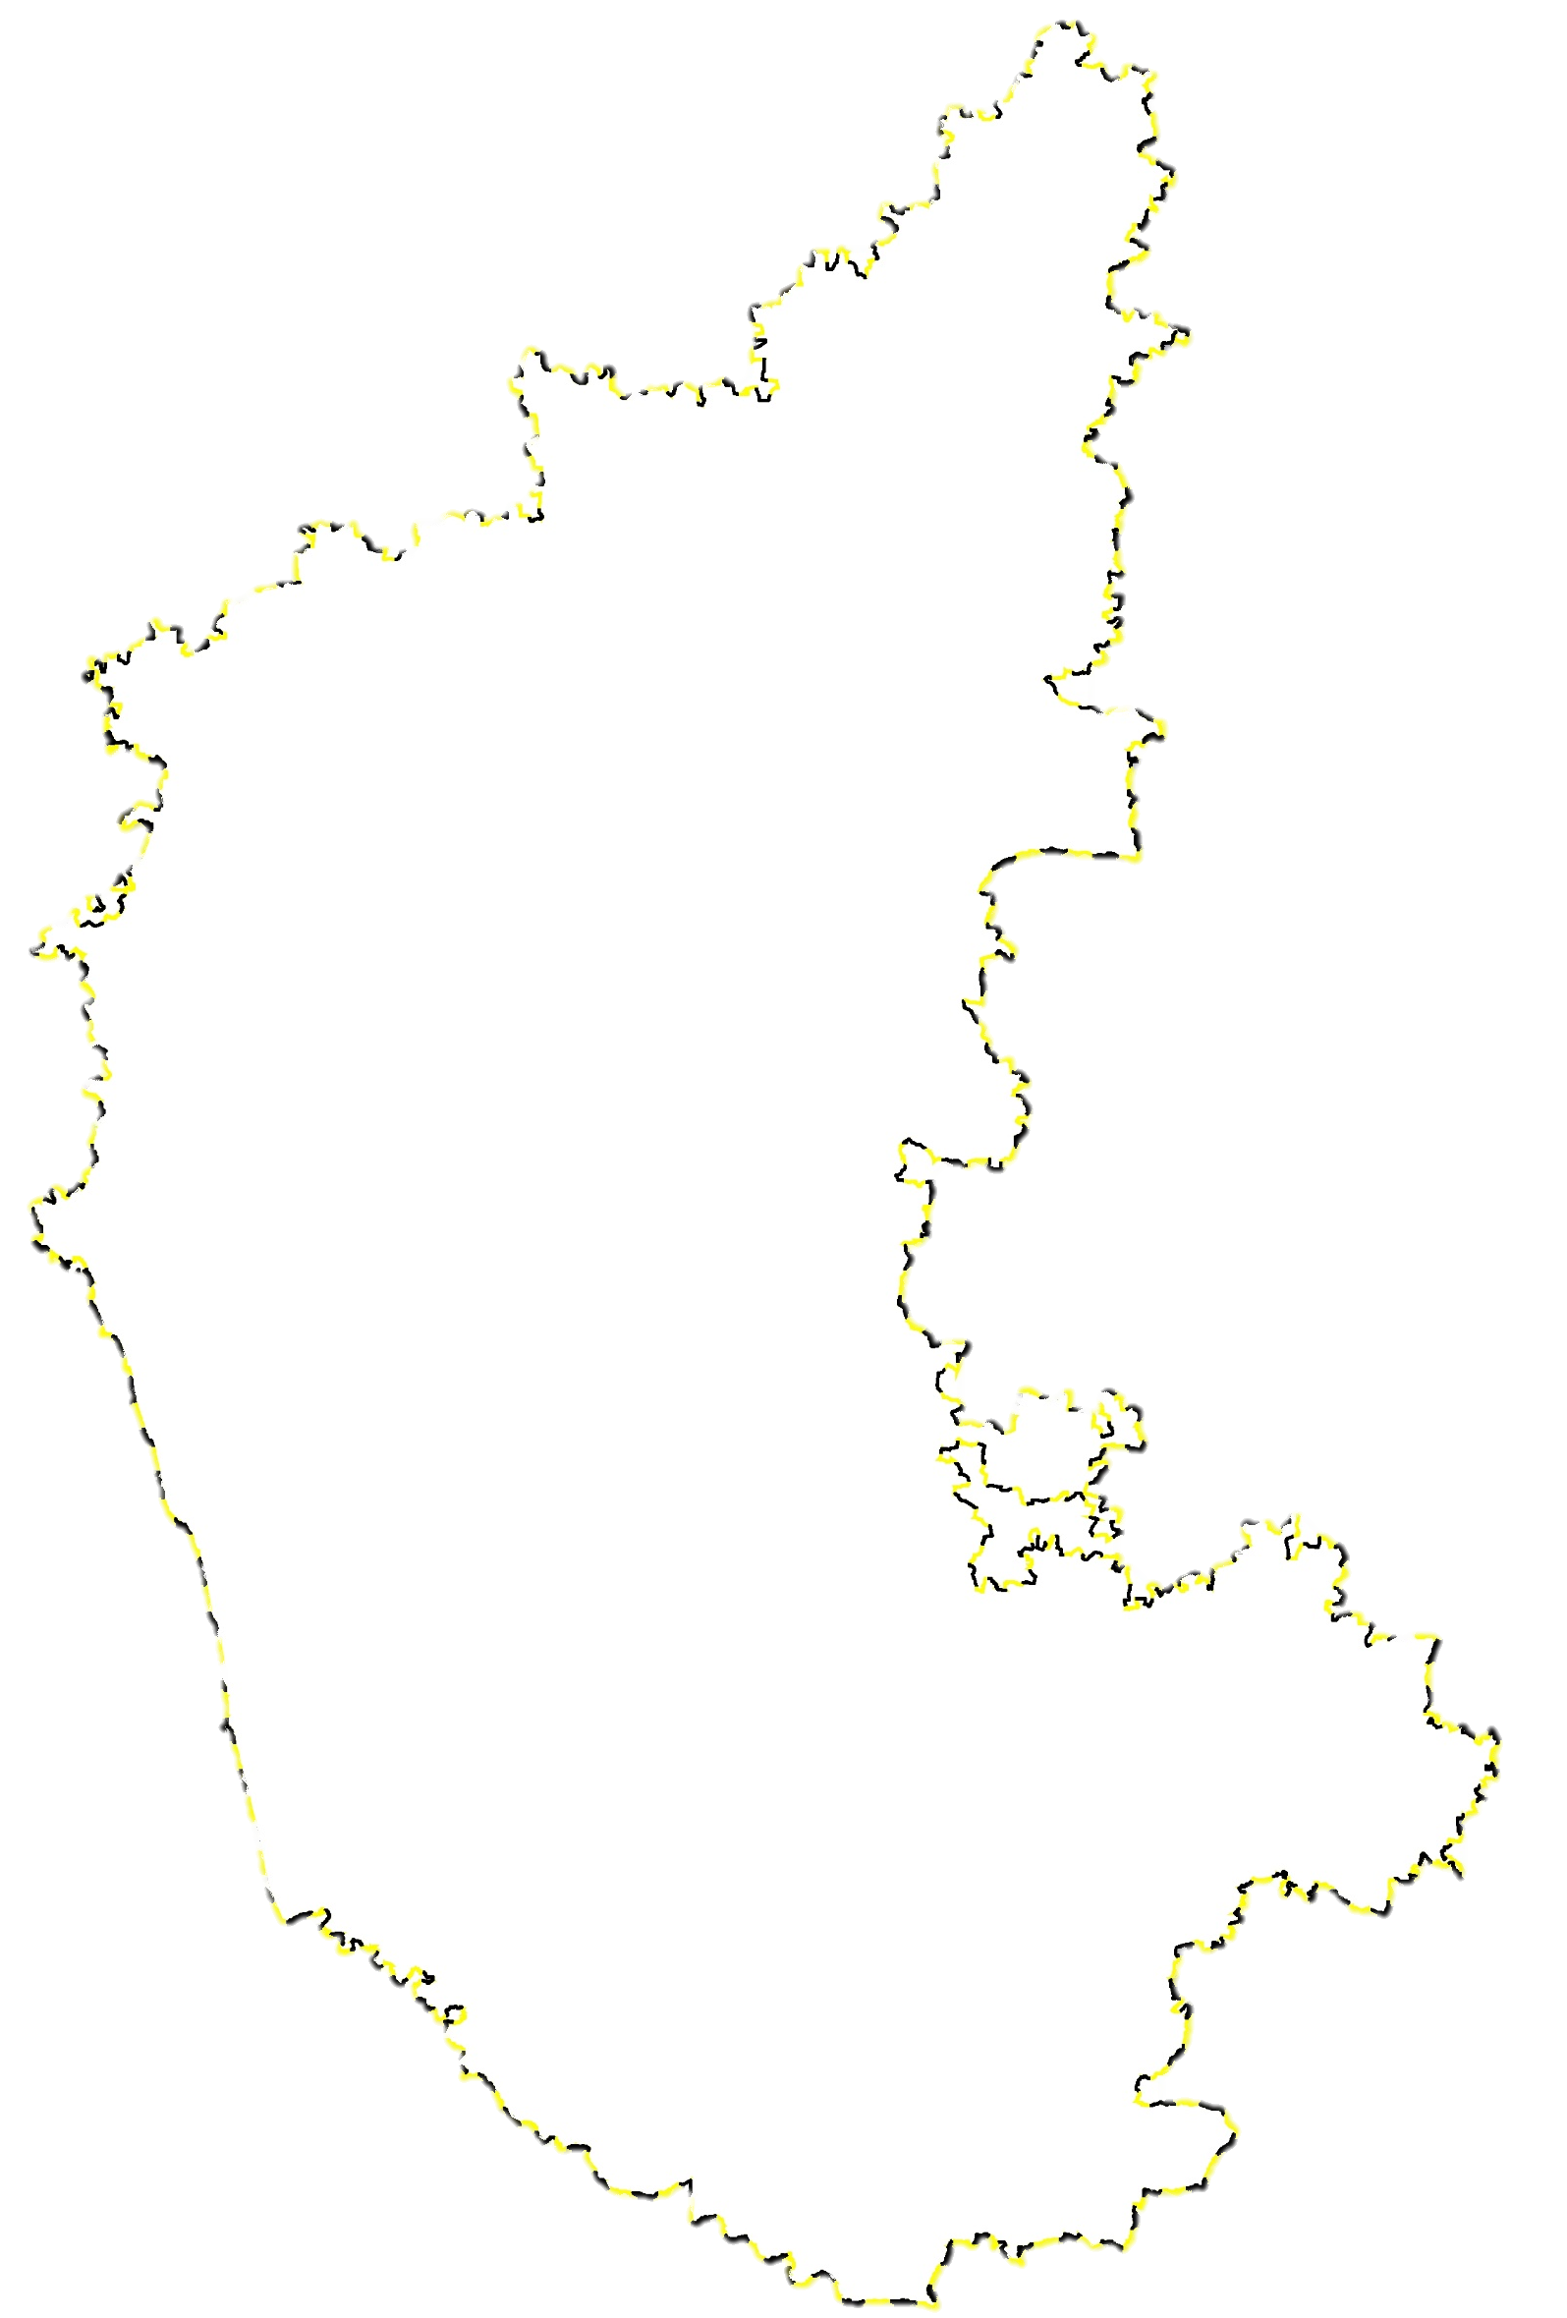
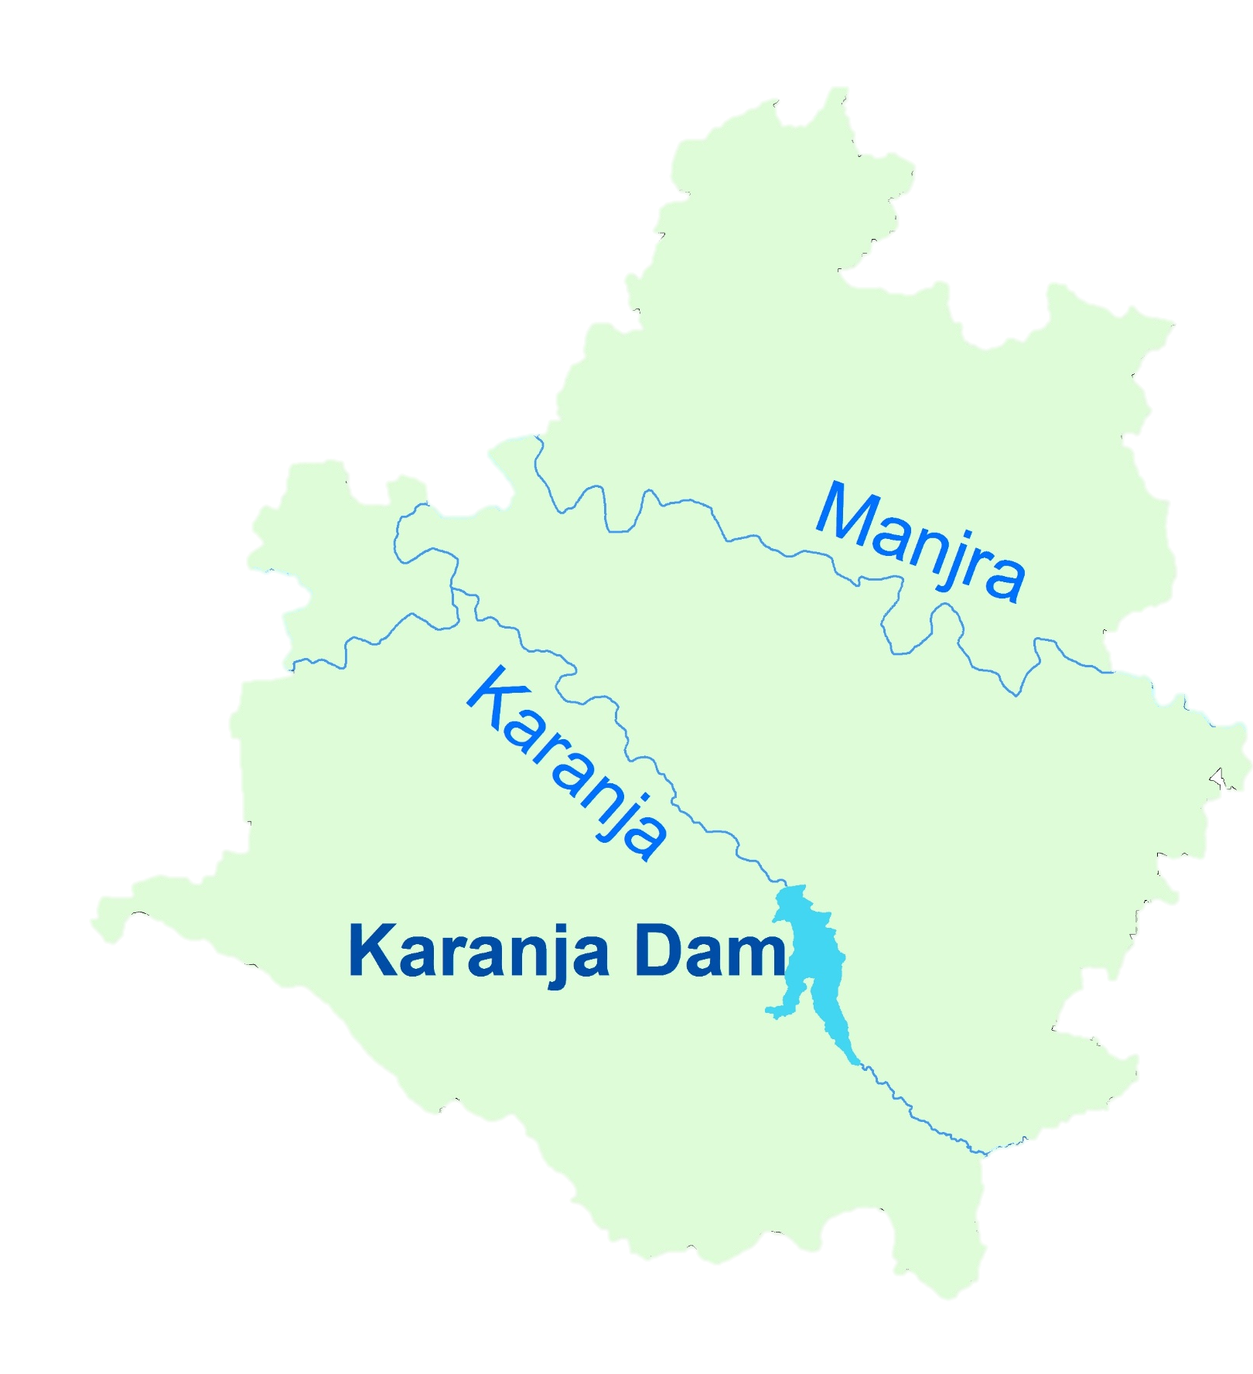
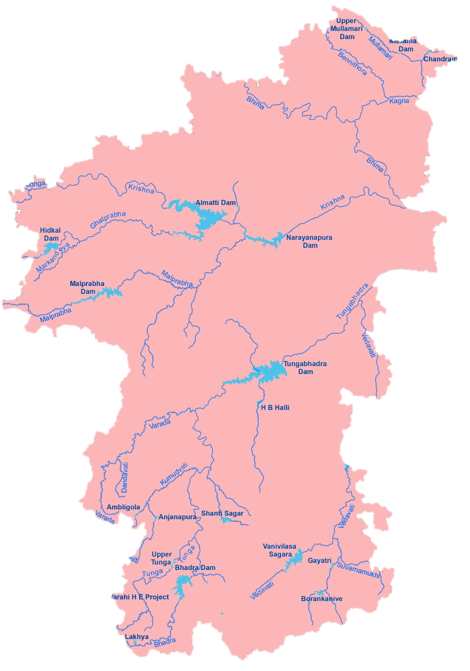
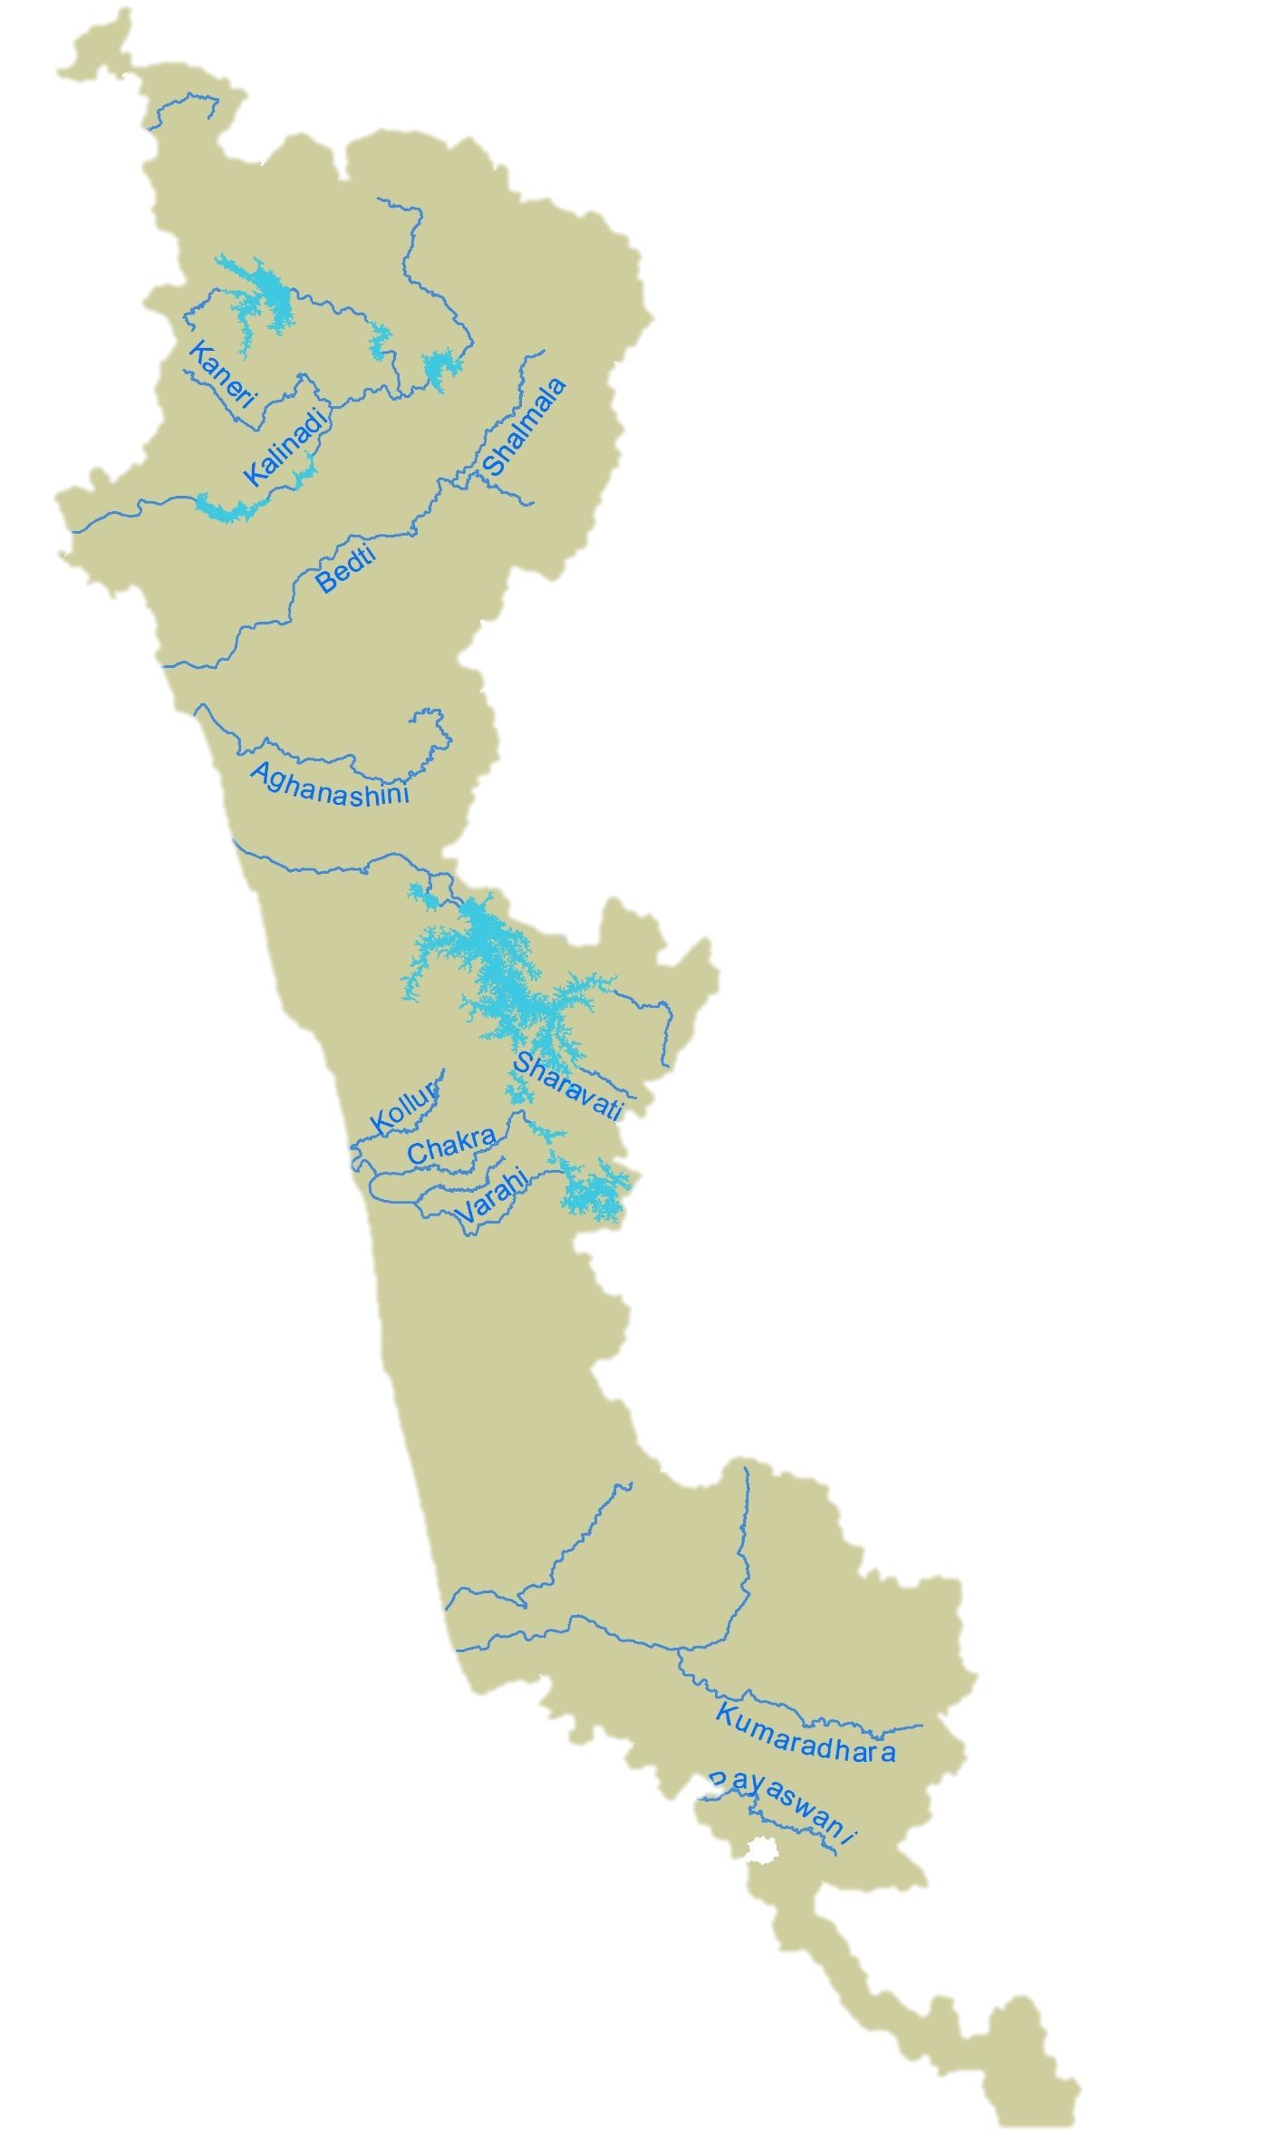
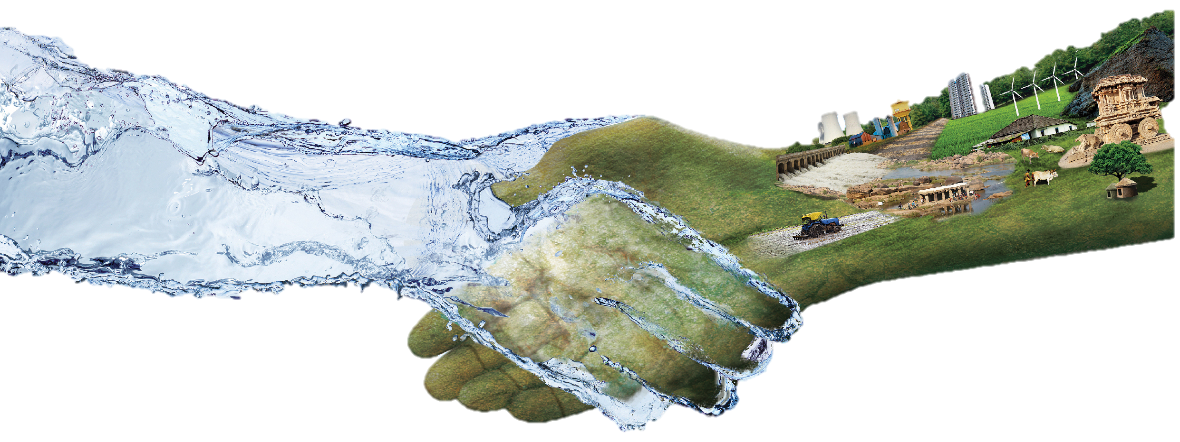
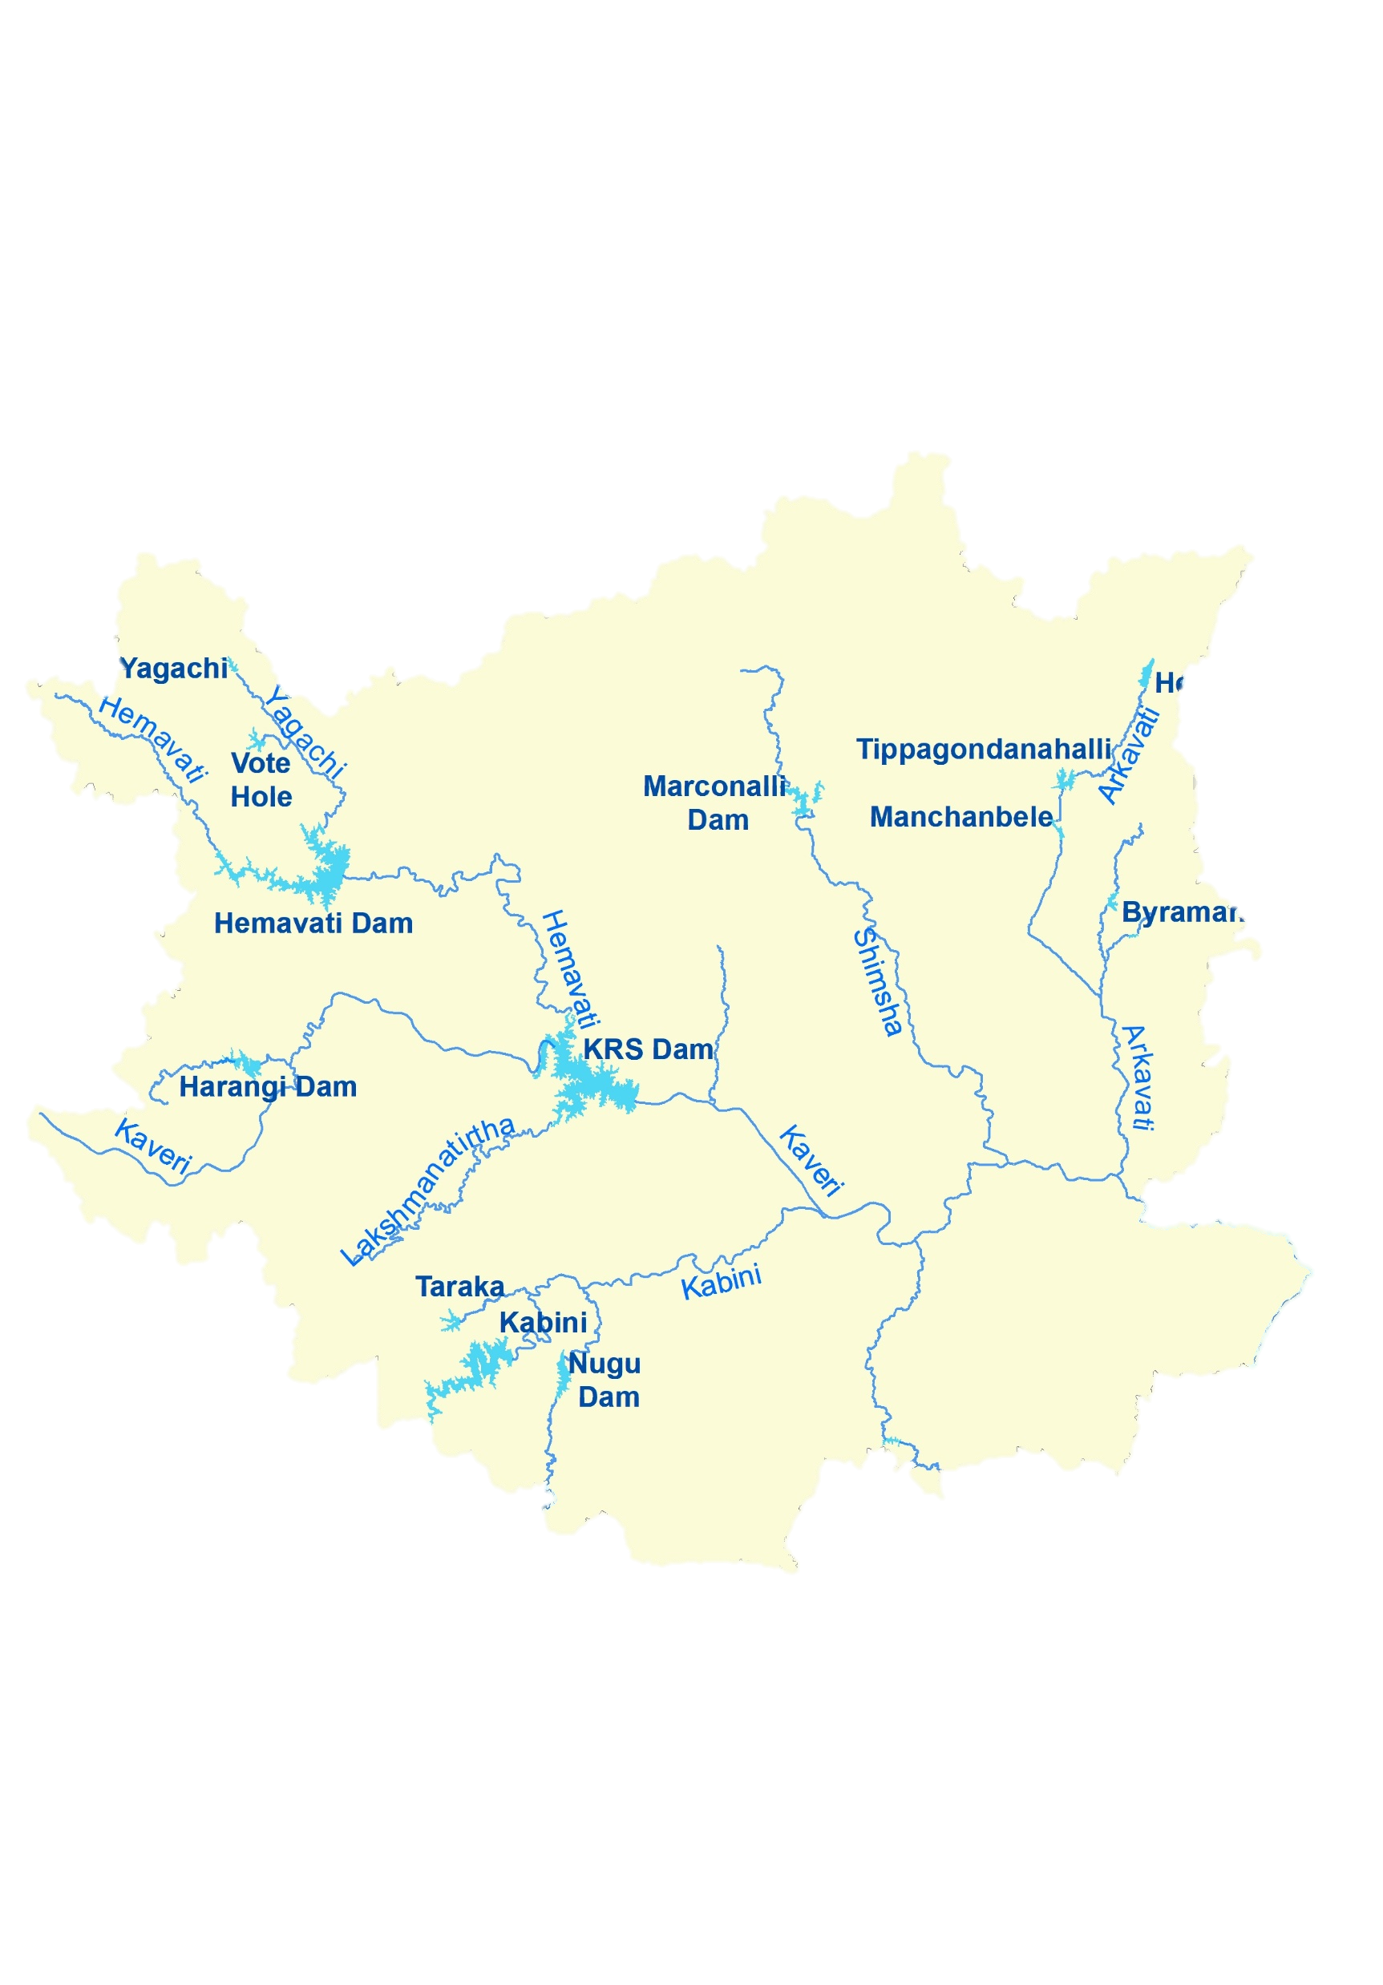
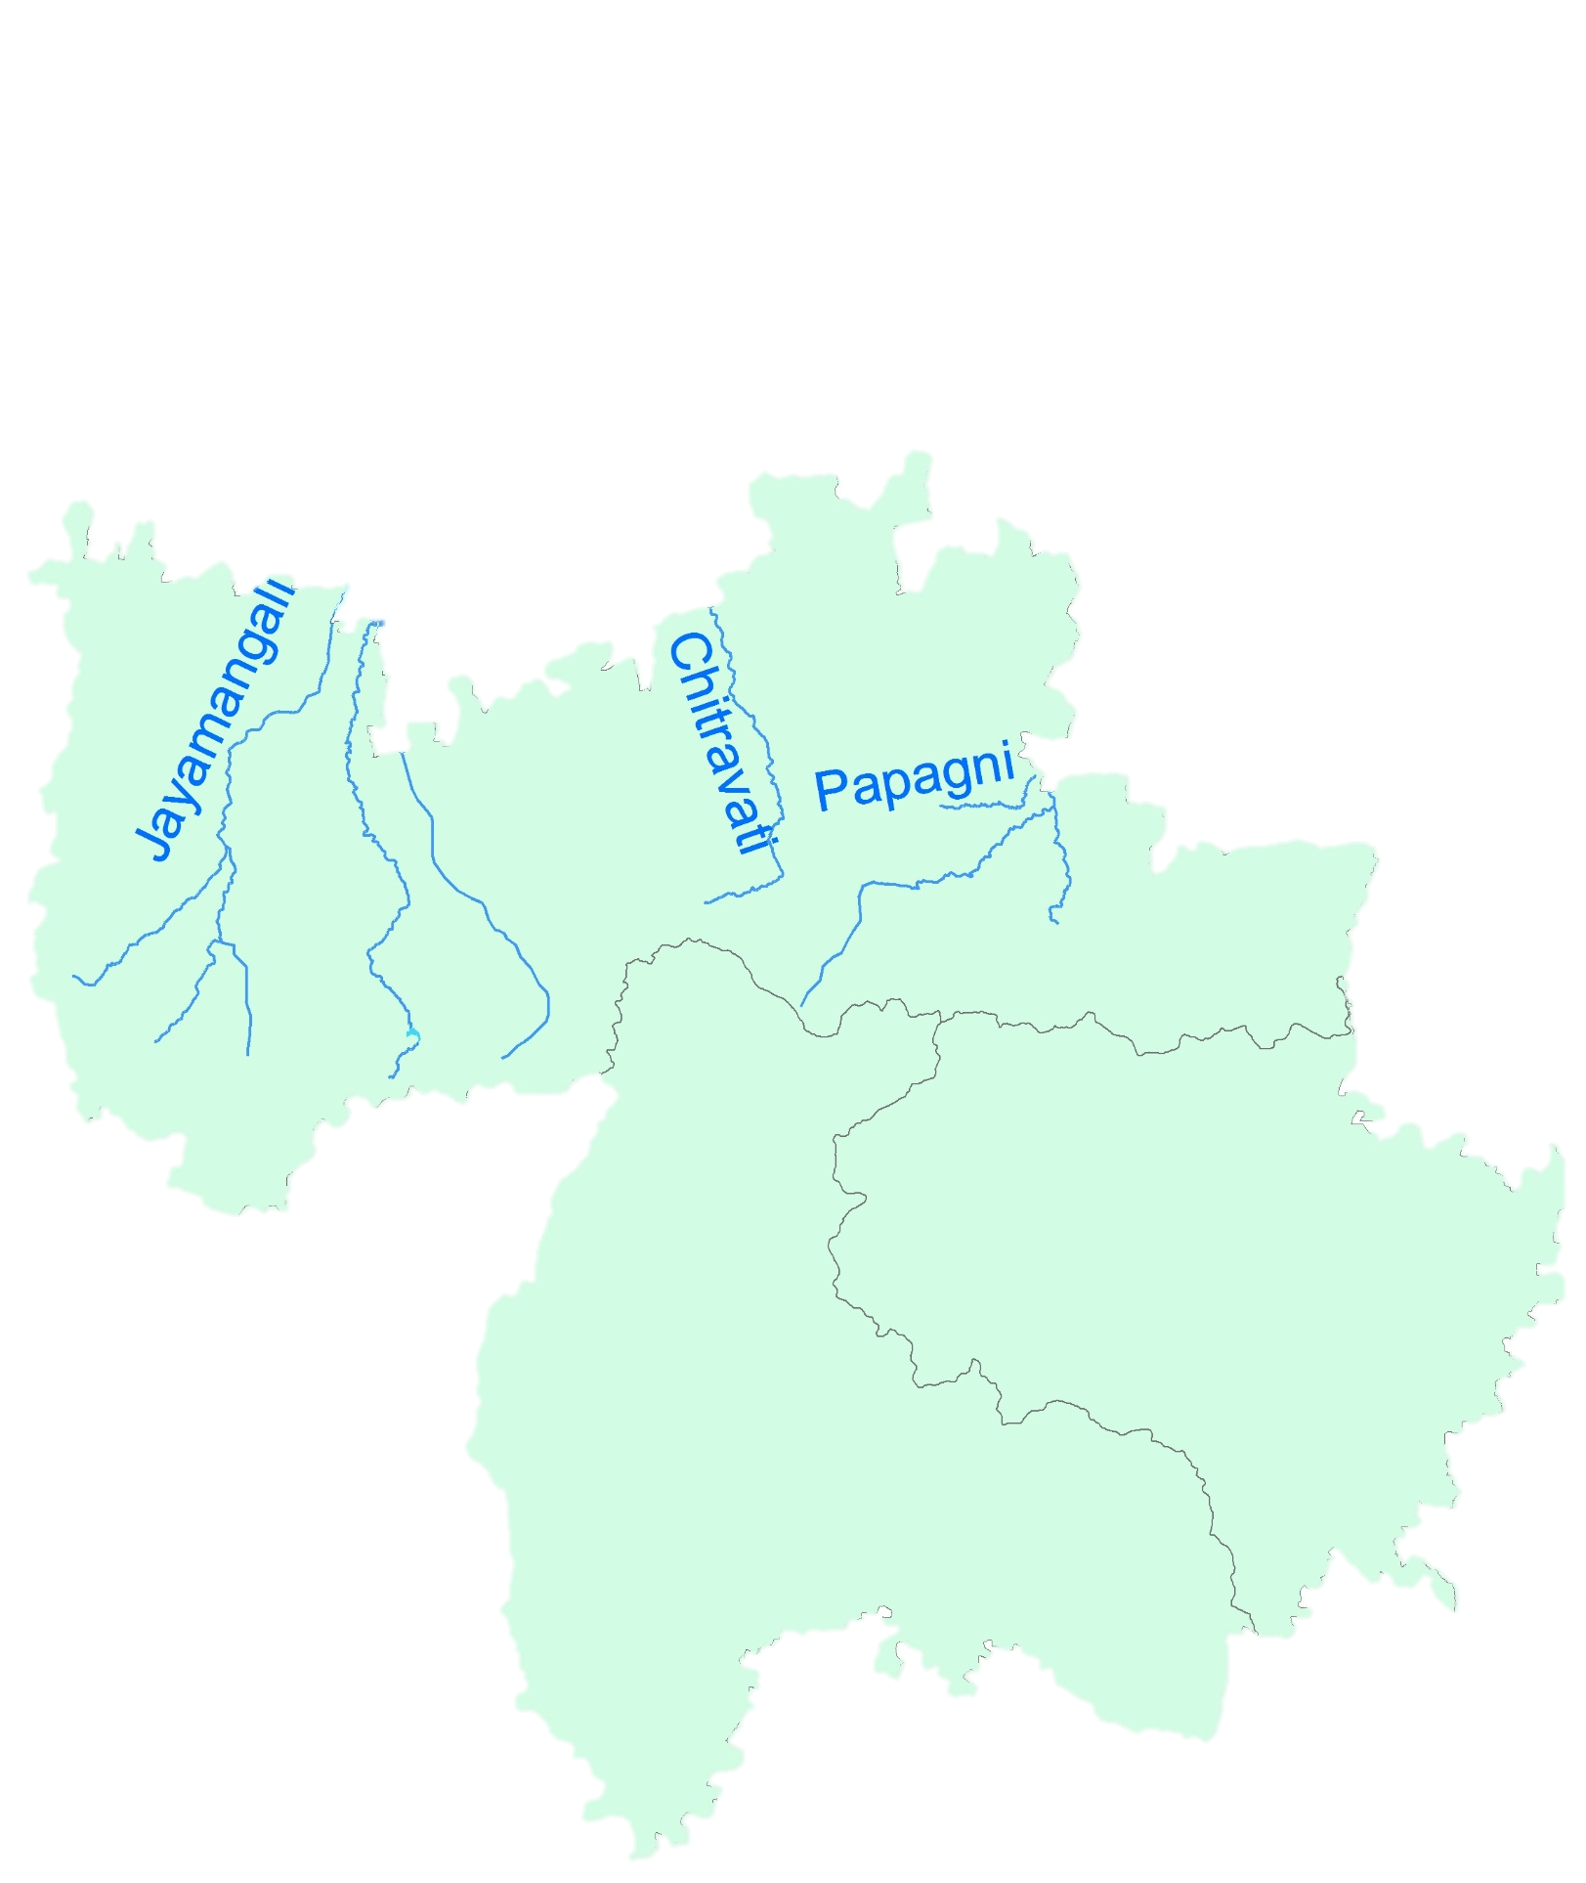
Thank You

